Slide 1
Rock, paper, Scisscors
By team var I = ‘team’

Slide 2
Communication Plan
How will your group communicate with each other?
We will be communicating both in person and over Slack.
What is your strategy for ensuring everyone's voices are heard, and that contributions from both loud and soft voices are listened to?
We have decided to implement a talking item. Whomever holds the item has the floor and others must refrain from interrupting.
Do you have a plan for managing psychological safety, as we learned about in the article on Google and teams and discussing it with Brook?
The talking item will ensure that everyone feels they have a say in the group.

Slide 3
Conflict plan
What will your group do when it encounters conflict?
Recognize that there is a problem and if serious enough, call a group meeting. If tensions arise, we have all agreed to take a break and reconvene afterwards with cooler minds.
What will your process be to resolve it?
We will talk through the problem until resolved. If tensions arise, we have all agreed to take a break and reconvene afterwards with cooler minds.

Slide 4
Git process
What is your Git flow?
Every 3 hours we will do a ACP. We all must add our names to our commits to prove that we all worked on different parts of the project.
How many people must review a PR?
In branches, the navigator in a pair reviews the PR. Pushing to master requires all group members review and approval.
If someone is working solo, they must have another person review and make the group aware. Same rules apply for master PR’s.
Who merges PRs?
In a pair, the navigator will merge. Solo, the reviewer will merge. Master, any group members who did not touch the code.

Slide 5
User scenarios
Billy Jo, was a young boy who was bullied at school. He felt so alone in theworld, as he would walk home sad from the bus stop every day. As winter continued on Billy decided he wanted to find solace online, which he then discovered rock paper scissors.
The game was simple but fun, Billy Jo found that he could find peace in the simple but engaging game. He steadily began to put hours into the game due to the fact that he can keep playing repeatedly and always come up with a relatively different result. His boredom decreased and enjoyment level increased. As his enjoyment increased, his confidence was boosted, so he began making more friends and it made him happier. Ultimately he became popular and liked while recommended the game to others and increased traffic to the application.

Slide 6
User stories MVP’s
As a user, I want an interactive and simple game that is easy to understand and use.
As a user, I want to be able to see no unfinished content and a clean appearance.
As a user, I want easy navigation of the application with no apparent faults within.
As a user, I want to be able to see who was behind creating the game.
As a user, I want to be able to clearly see the results of every game.
As a user, I want to be able to input my screenname and have the game keep track of my score.
As a user, I want to have the ability to select the length of the game to play in one sitting.

Slide 7
User stories stretch goals
As a user, I would like playful, animated icons that are stimulating and attractive.
As a user, I want to play an interactive game separate but in conjunction with the base rock paper scissors game.
As a user, I want a time limit or play limit that keeps the game feeling like it has a pace that needs to be kept.
As a user, I want an engaging event or boss battle that is more challenging than the base game.
As a user, I want to be able to share and brag about my scores with my social media followers.

Slide 8
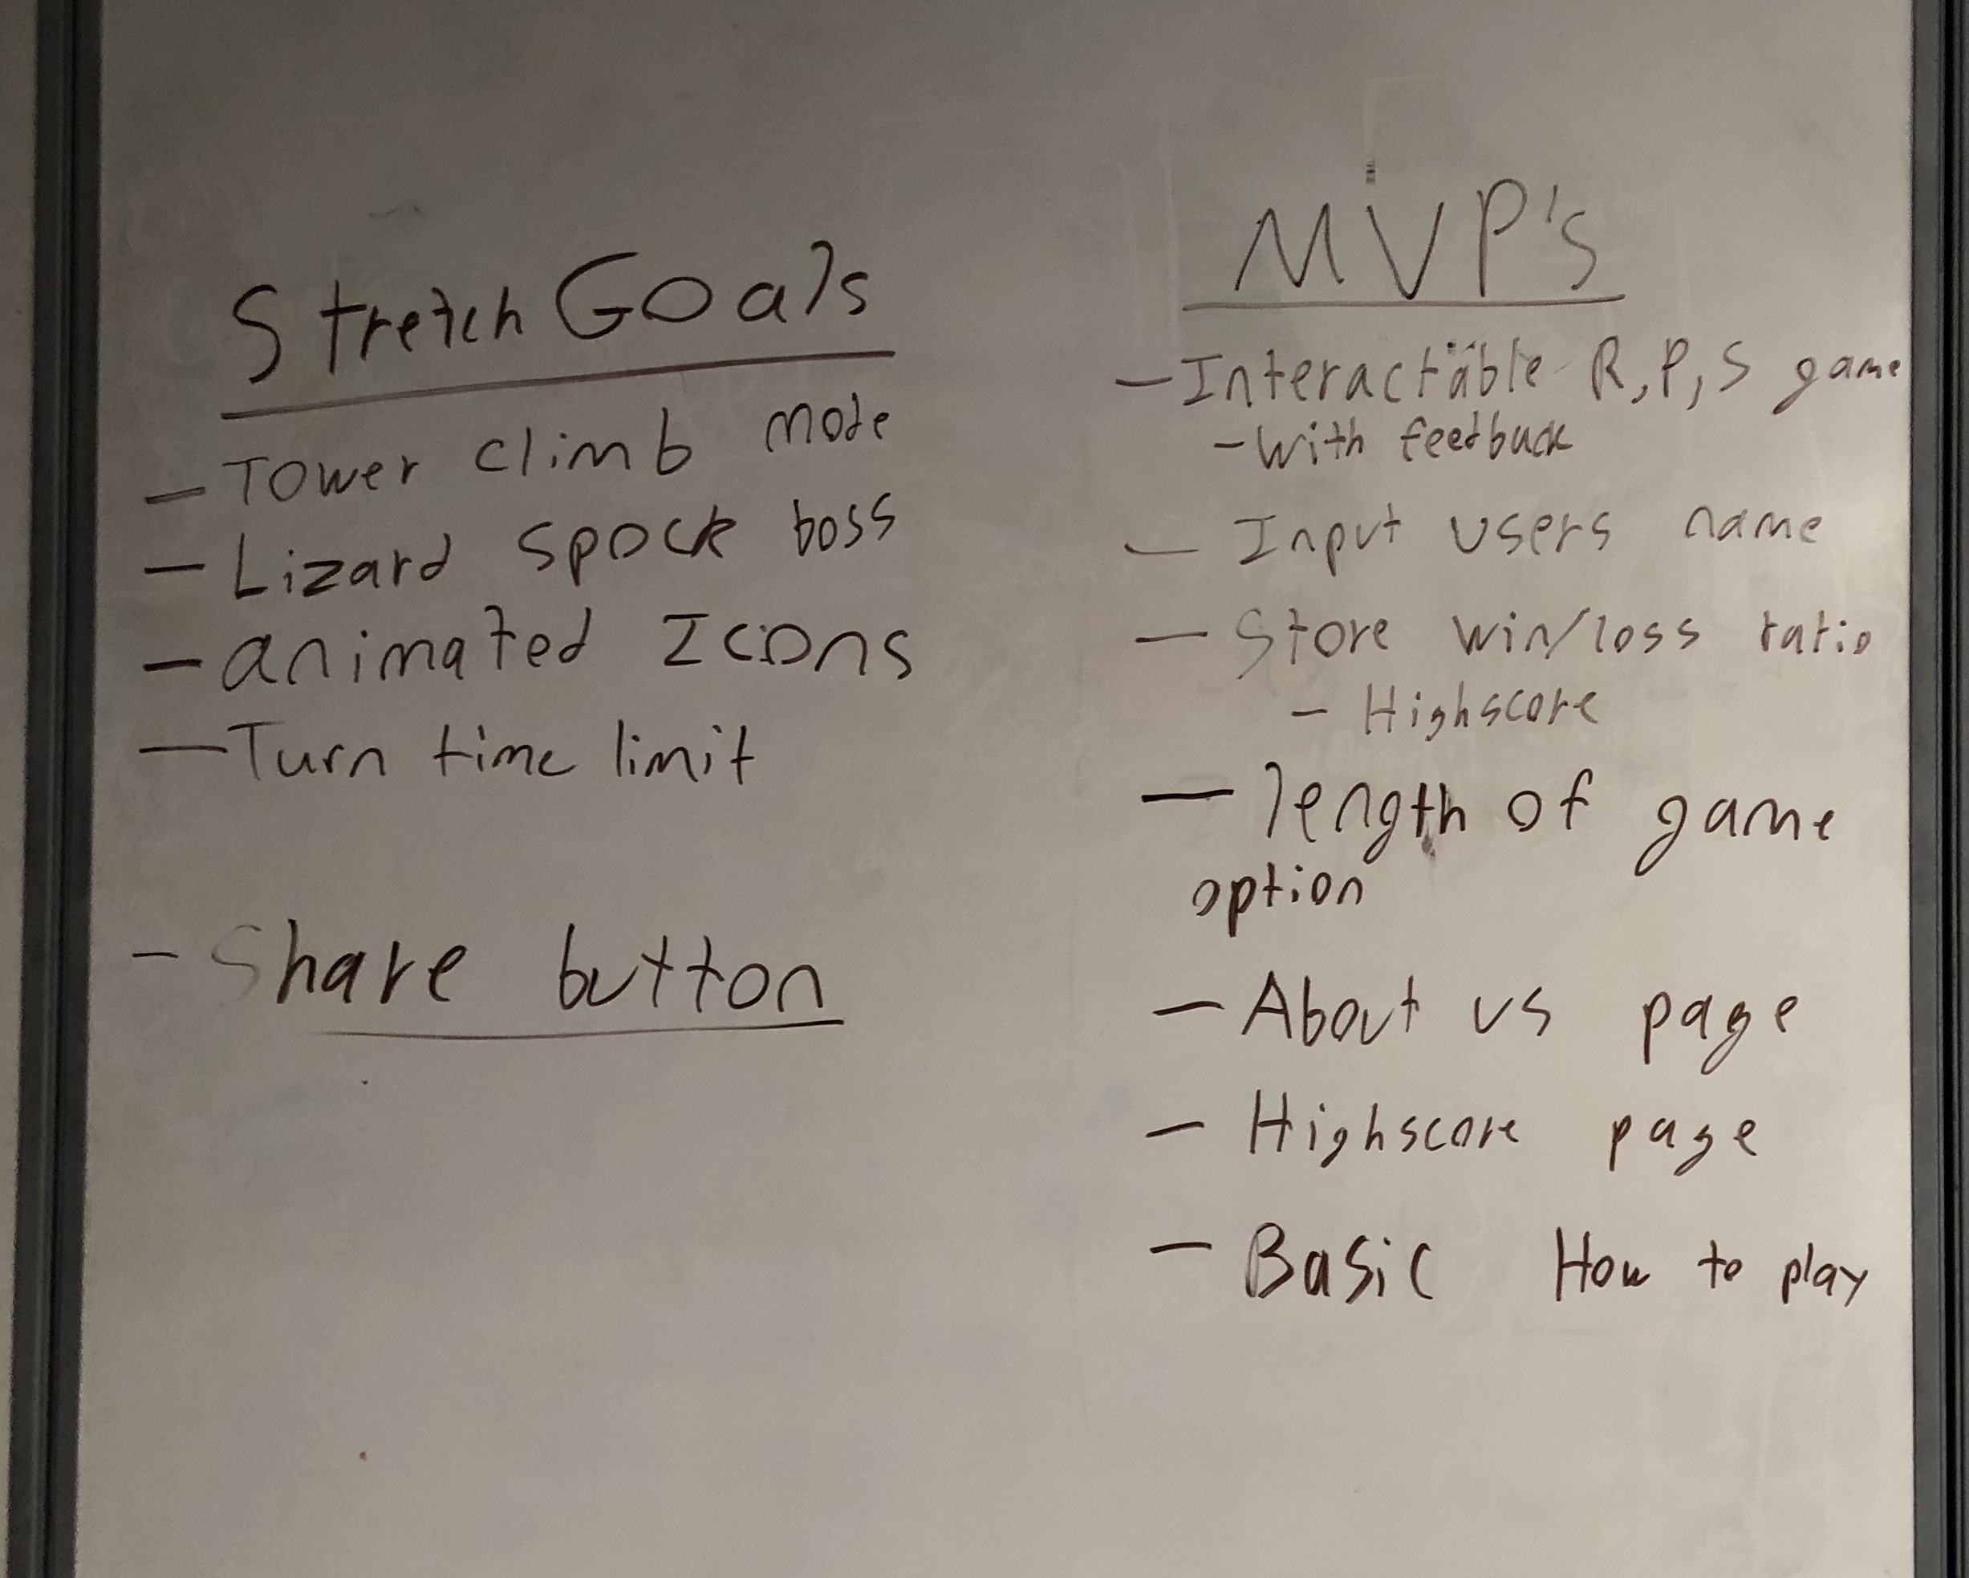
MVP’s and stretch

Slide 9
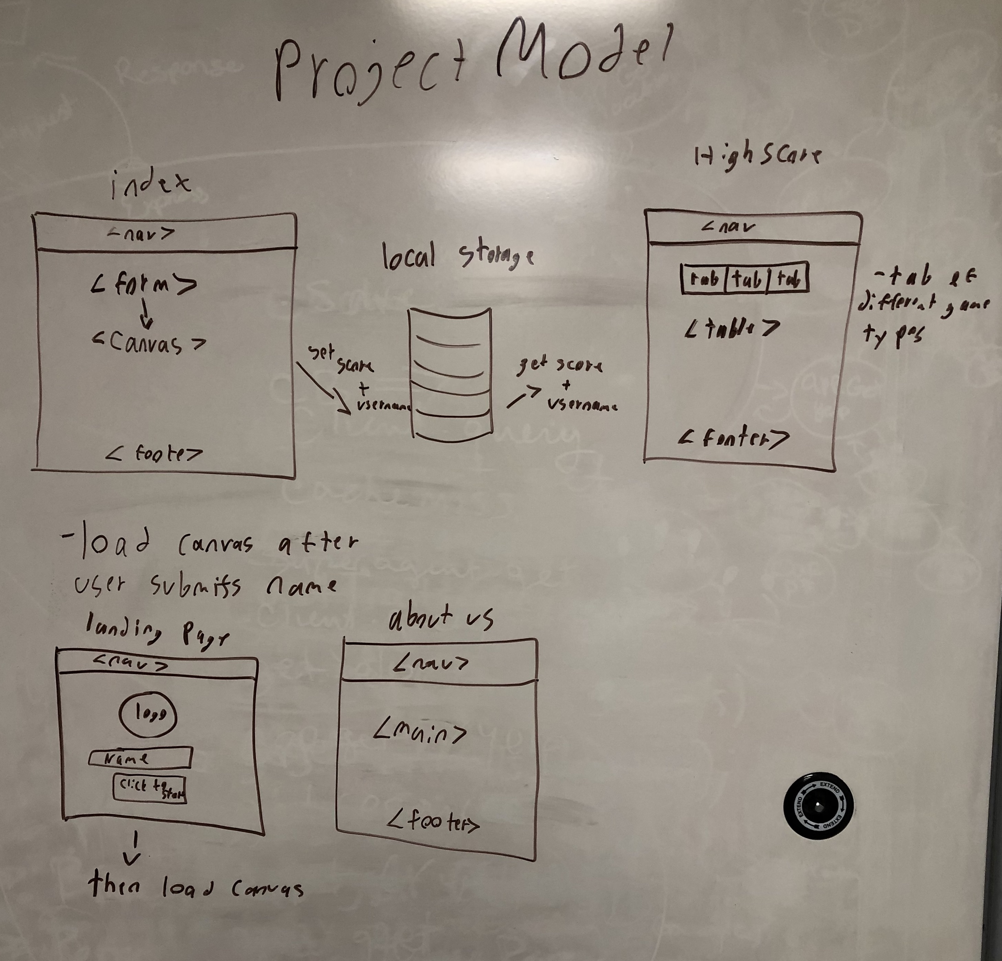
Project model

Slide 10
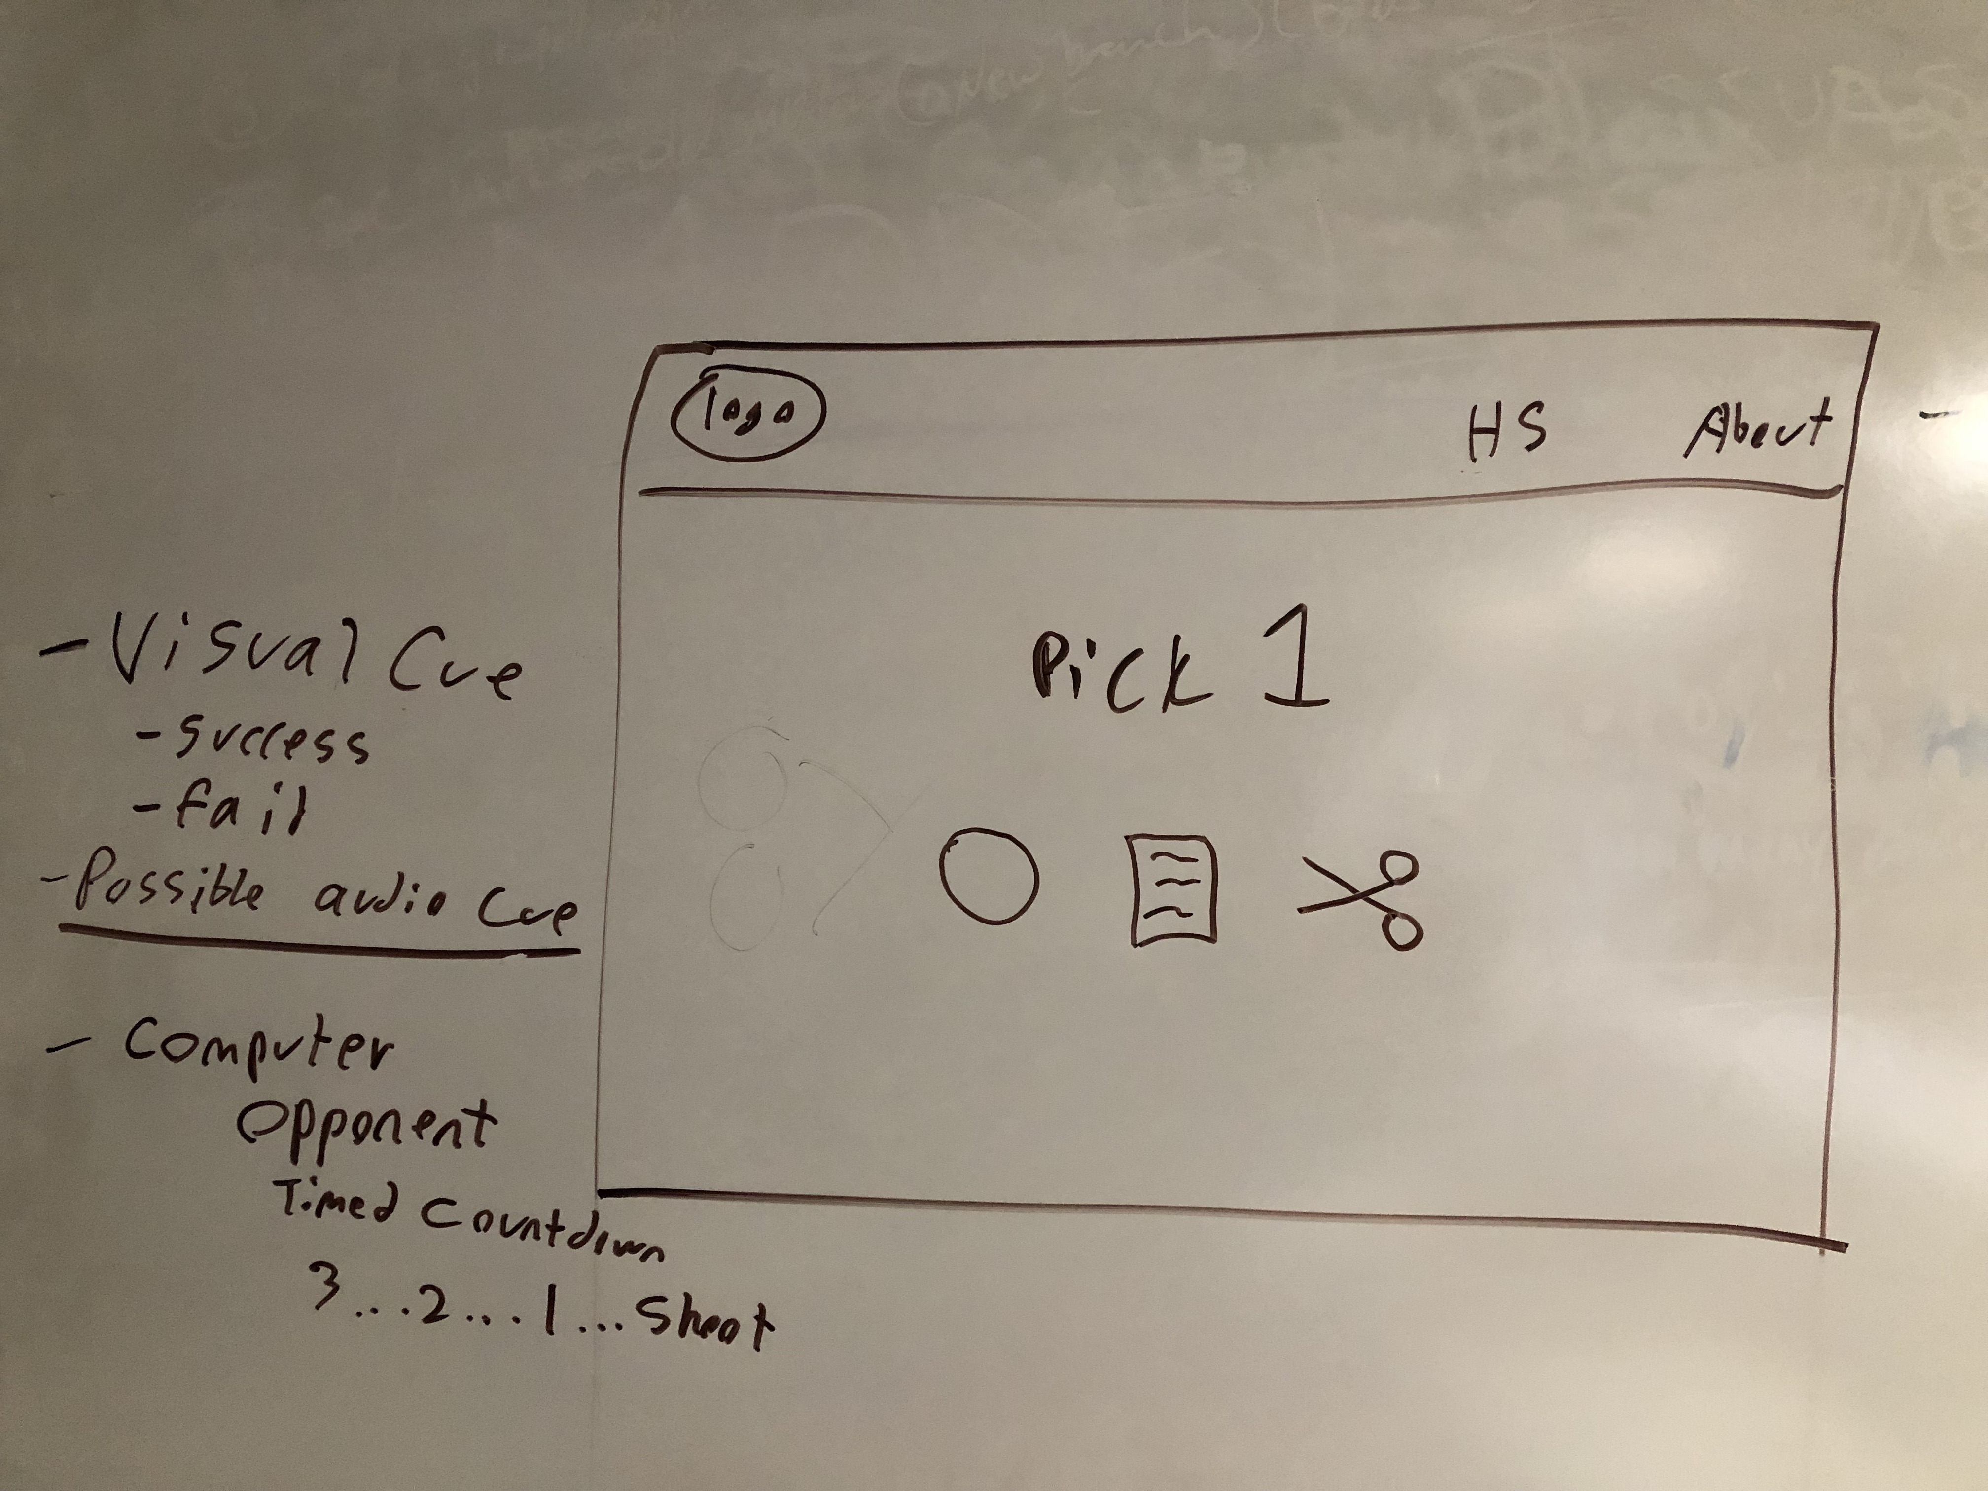
wireframes

Slide 11
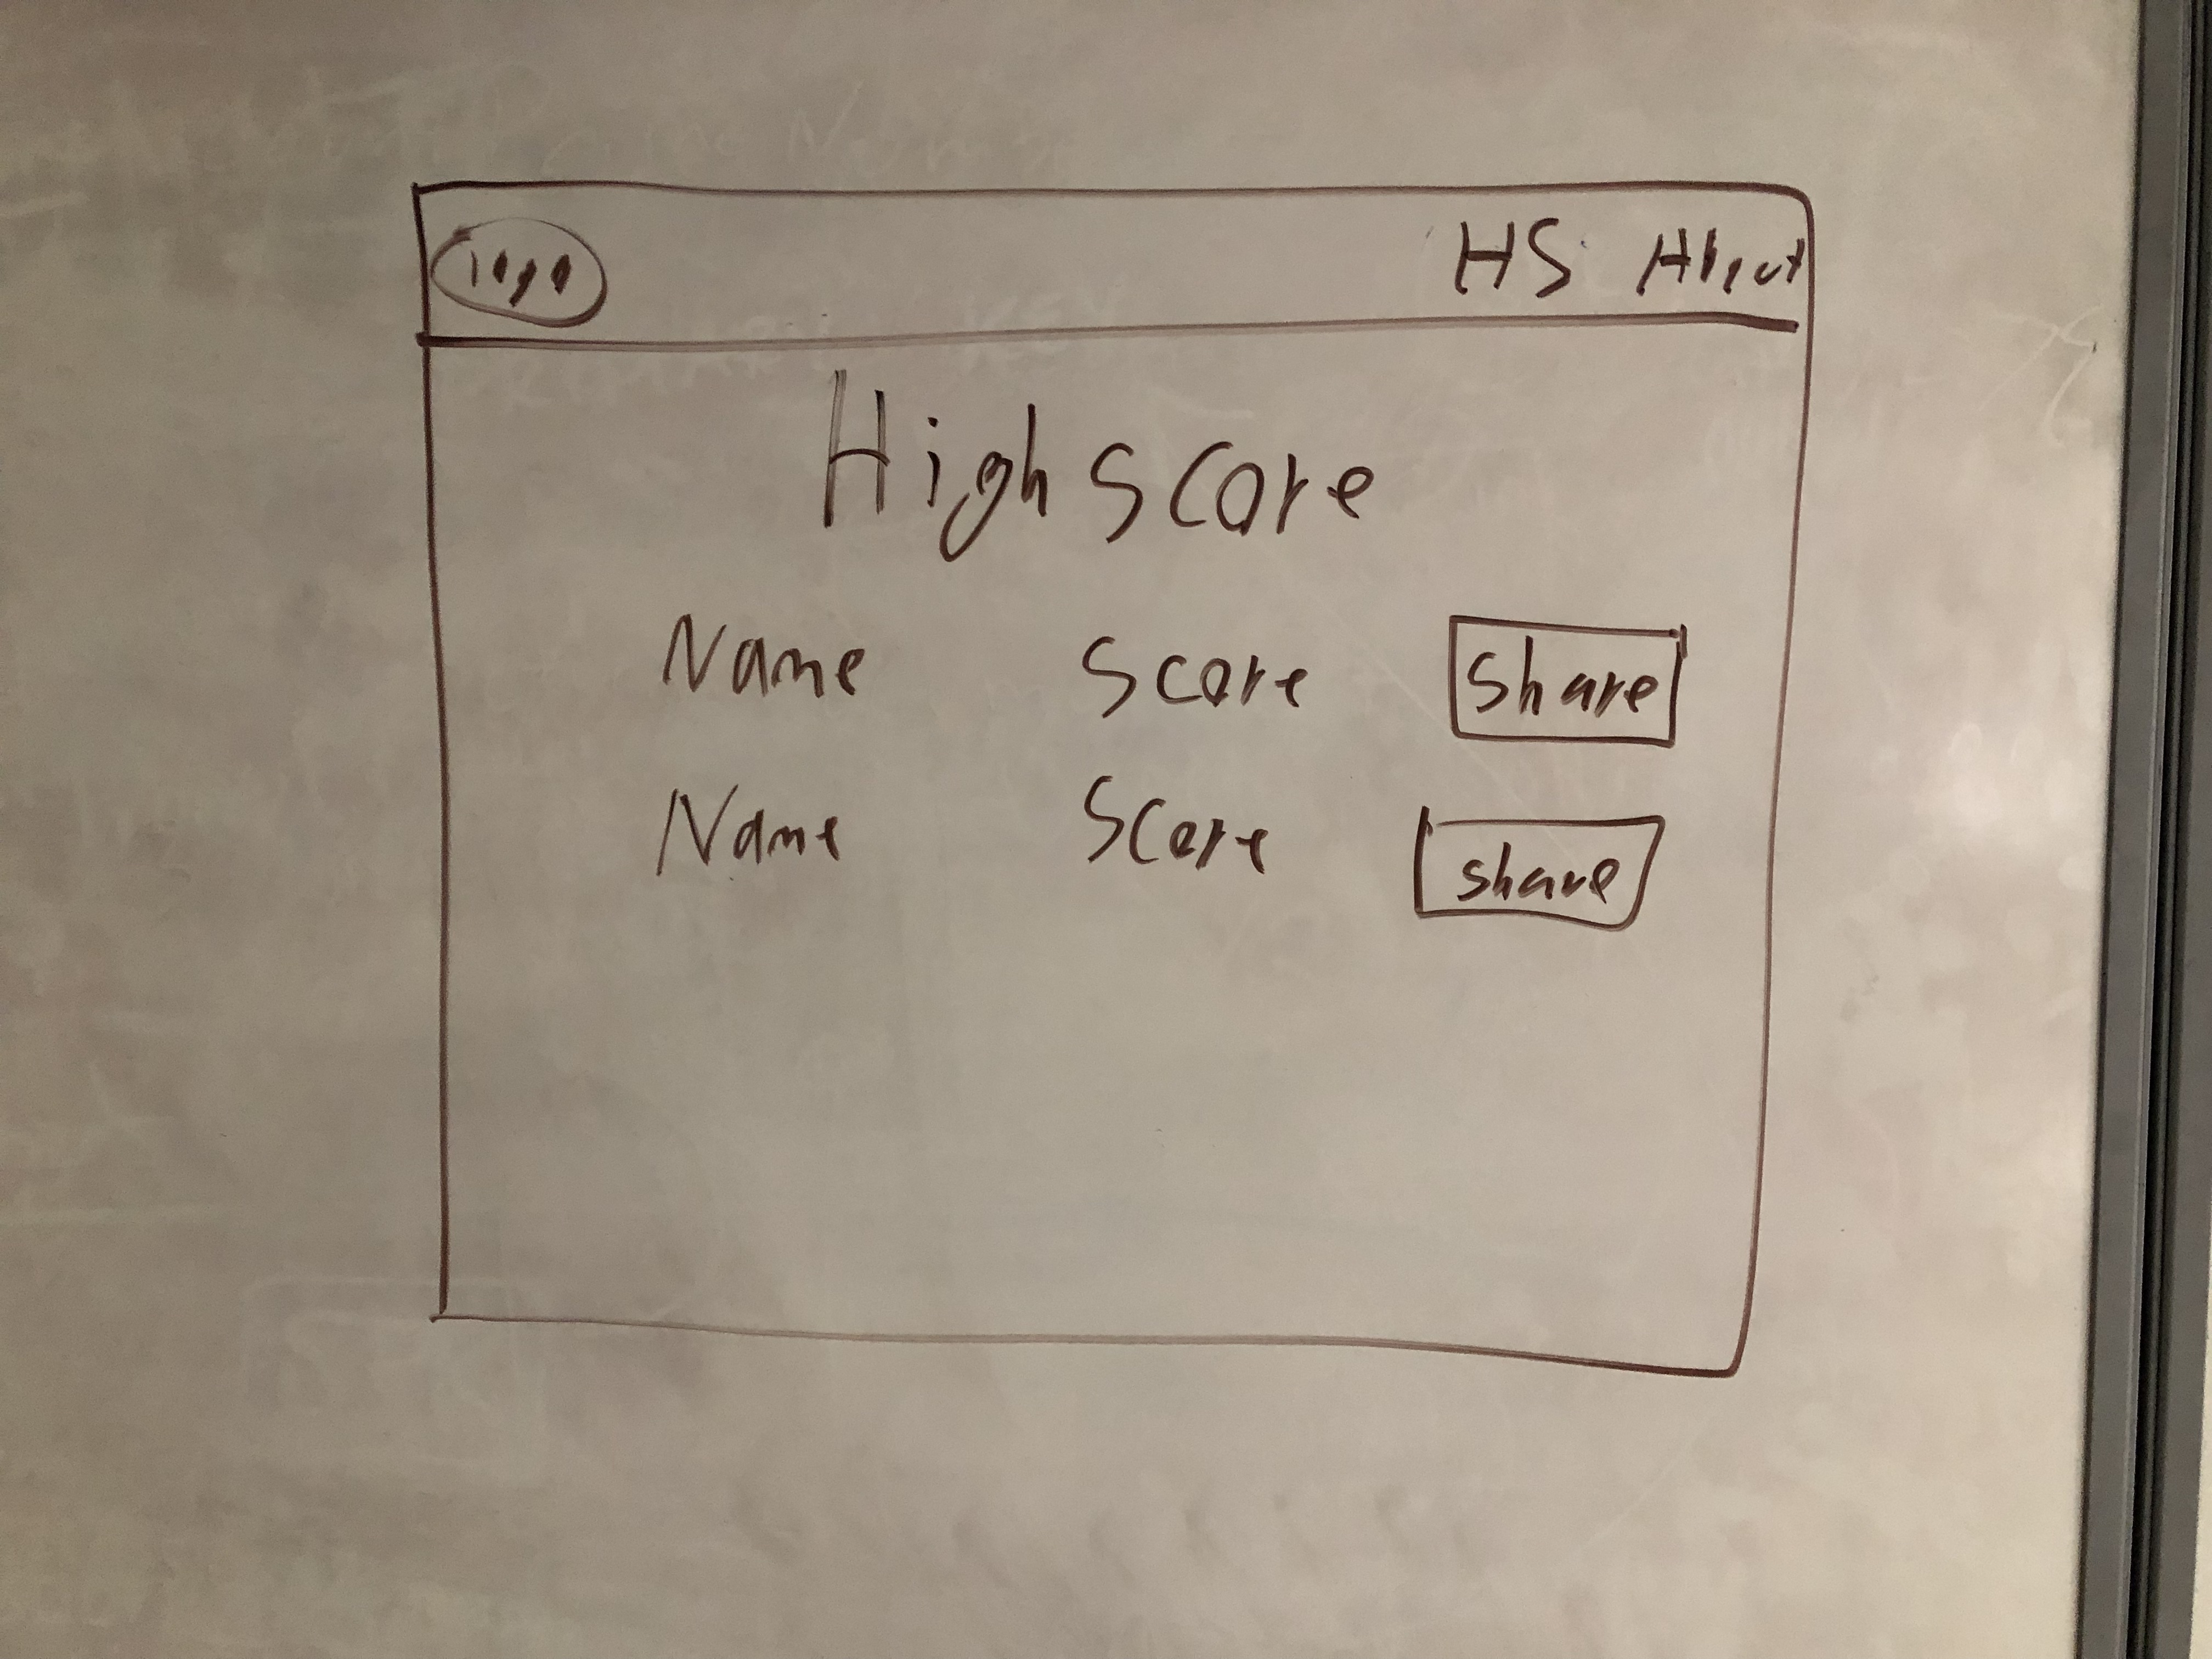
wireframes

Slide 12
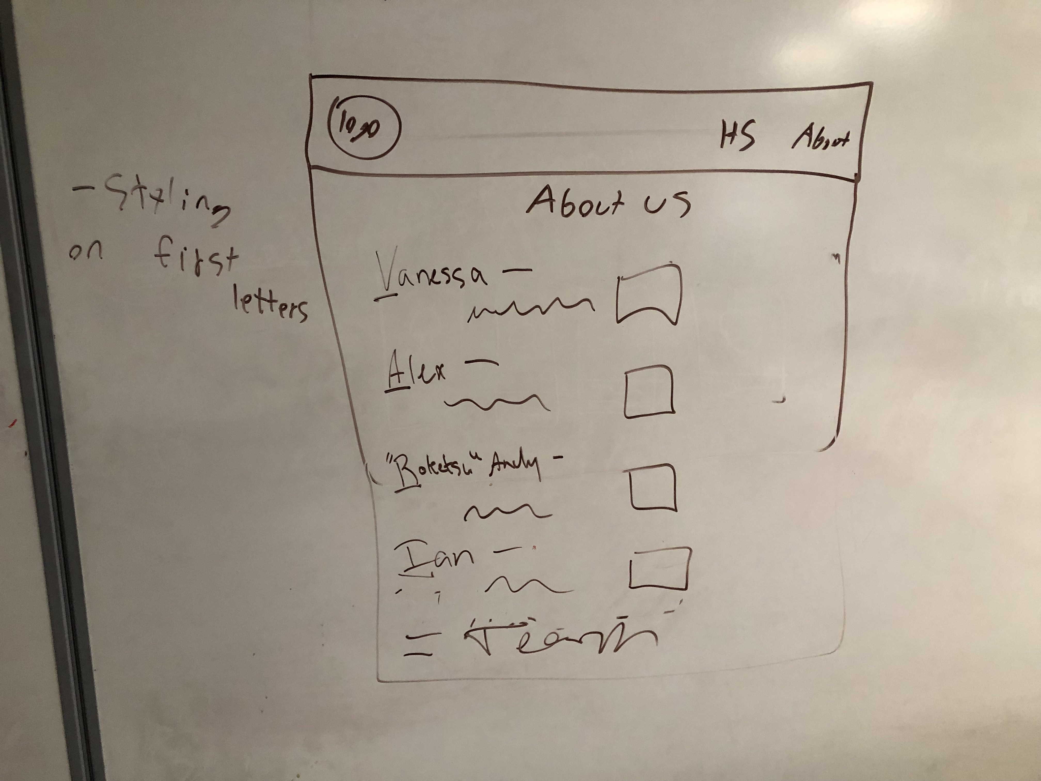
wireframes

